Slide 1
Agile Software Development
Software Engineering
Neil Toporski

Slide 2
1. Plan-Driven and Agile Development [Outline]
Agile methodology
Plan-driven vs agile development
Manifesto for Agile software development

Slide 3
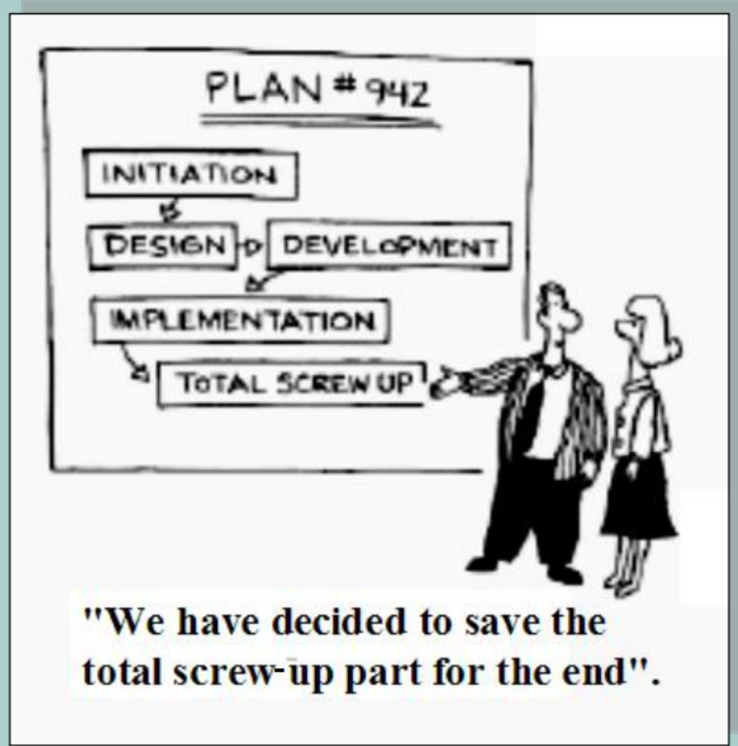
1.1 Agile Methodology
Agile Methodology is a people-focused, results-focused approach to software development that respects our rapidly changing world. It’s centered around adaptive planning, self-organization, and short delivery times. It’s flexible, fast, and aims for continuous improvements in quality.

Slide 4
1.2 Plan-Driven and Agile Development
Plan-driven development
A plan-driven approach to software engineering is based around separate development stages with the outputs to be produced at each of these stages planned-in-advance.
E.g Waterfall.
Iteration occurs within, not across, activities.
formal documents are used to communicate between stages of the process.
Not geared for rapid development.
Agile development
The system is developed in a series of increments.
Specification, design, implementation and testing are inter-leaved and the outputs from the development process are decided through a process of negotiation during the software development process.
A cadence of multiple deliverables (increments) is better able to help a project keep progress and provide better estimates rather than having everything be "80% done."
Less importance on formal documentation.
Agile methods are designed to produces ”useful” software quickly.

Slide 5
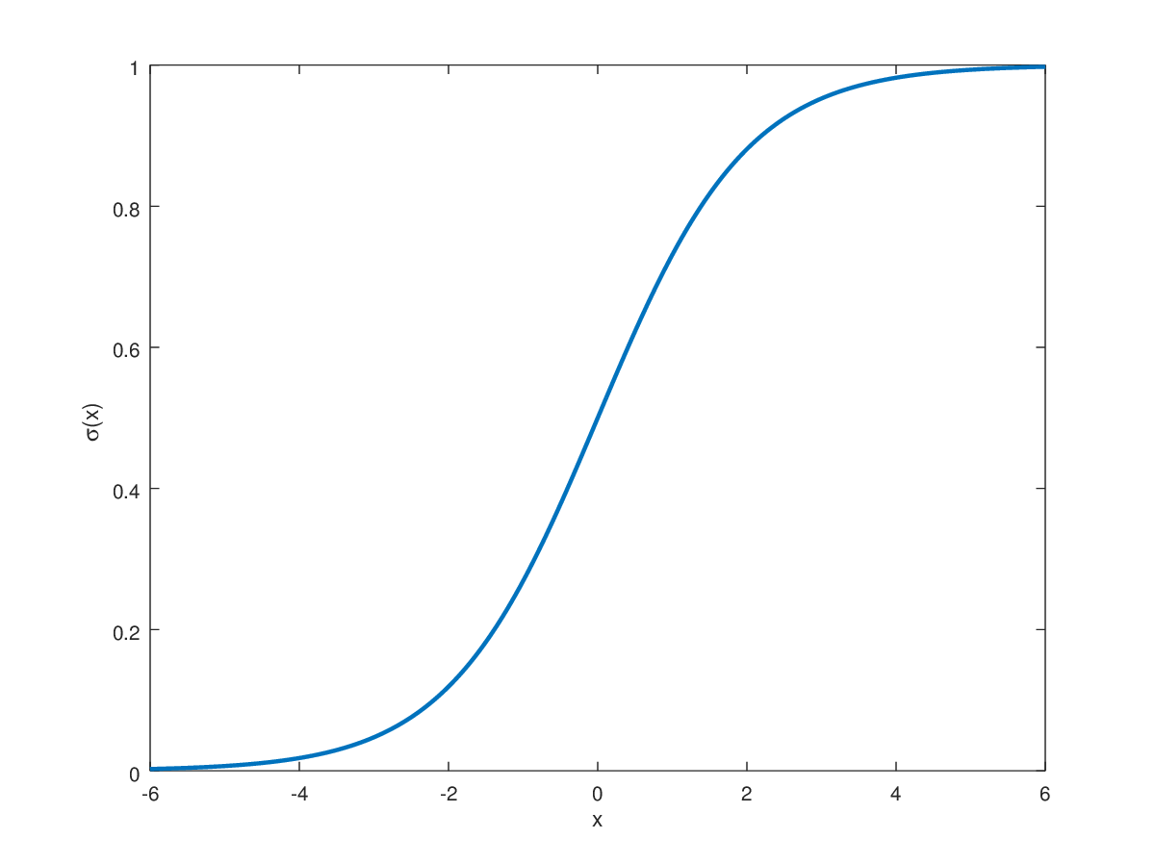
Good Enough Theory
Result
Effort

Slide 6
1.3 Manifesto for Agile Software Development
On February 2001, 17 software developers met at the Snowbird resort in Utah to discuss lightweight development methods and the need to find common ground among scrum. They published the Manifesto for Agile Software Development.
Individuals and interactions over processes and tools.
Working software over comprehensive documentation.
Customer collaboration over contract negotiation.
Responding to change over following a plan.
That is, while there is value in the items on the right, we value the items on the left more.
Notes:
I need something now vs lots of documentation

Slide 7

Snowbird Lodge

Slide 8

Where I Usually Stay

Slide 9
Twelve Principles of the Agile Manifesto
Our highest priority is to satisfy the customer through early and continuous delivery of valuable software.
Welcome changing requirements, even late in development. Agile processes harness change for the customer's competitive advantage.
Deliver working software frequently, from a couple of weeks to a couple of months, with a preference to the shorter timescale.
Businesses and developers must work together daily throughout the project.
Build projects around motivated individuals. Give them the environment and support they need and trust them to get the job done.
The most efficient and effective method of conveying information to and within a development team is face-to-face conversation.
Working software is the primary measure of progress.
Agile processes promote sustainable development. The sponsors, developers, and users should be able to maintain a constant pace indefinitely.
Continuous attention to technical excellence and good design enhances agility.
Simplicity--the art of maximizing the amount of work not done -- is essential.
The best architectures, requirements, and designs emerge from self-organizing teams.
At regular intervals, the team reflects on how to become more effective, then tunes and adjusts its behavior accordingly

Slide 10
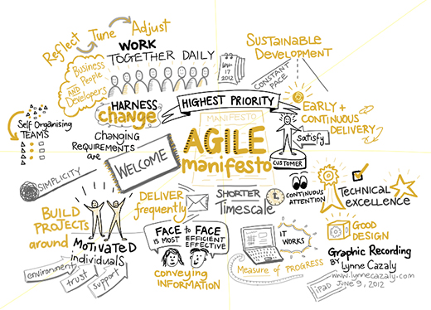
Agile Manifesto Explained

Slide 11
2. Agile vs Scrum [Outline]
Agile vs Scrum
Agile programming and methods
What is Scrum?
Empiricism
The complexity of software development

Slide 12
2.1 Agile vs Scrum?
Scrum is an Agile framework to develop, deliver and sustain complex products. Scrum originally was formalized for software development projects, but it works well for any complex, innovative scope of work.
Agile is a set of values and principles centered around the idea of iterative development where Scrum is about getting things done. Shipping value to customers. Scrum used by HR, marketing, design, engineering, and in particular, software development.
Software is a living, breathing thing. Requirements change, goals change, situations change. Scrum embraces change.
With Scrum, A product is built in a series of interactions called Sprints – break down big, complex projects into bite size pieces.
Makes development more manageable. More flexible to adapt and change adaptability.
Short iterations reduce risks and costs. Gets high quality products faster to market.
Milestones come frequently – Gives teams a sense of regular and tangible progress.
Notes:
Milestones every 2 weeks

Slide 13
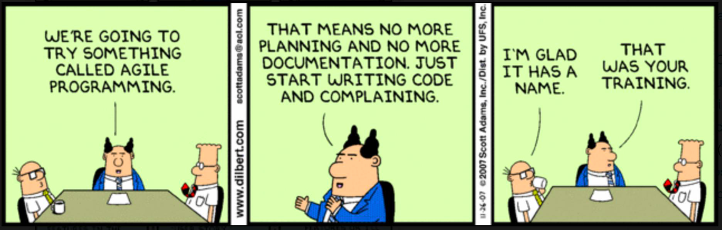
2.2 Agile Programming
The aim of agile methods is to reduce overheads in the software process (e.g. by limiting documentation) and to be able to respond quickly to changing requirements without excessive rework.
Notes:
A bunch of documents created vs 1 formal doc

Slide 14
2.3 What is Scrum?
Scrum is a framework/methodology that helps teams work together. ... Often thought of as an agile project management framework, scrum describes a set of meetings, tools, and roles that work in concert to help teams structure and manage their work.

Slide 15
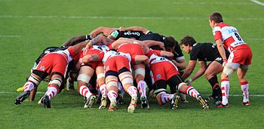
What is Scrum?
The term 'Scrum’ (short for scrummage) was first used by Hirotaka Takeuchi and Ikujiro Nonaka in their ground-breaking 1986 paper “The New Product Development Game“. They borrowed the name from the game of rugby to stress the importance of teams in complex product development.

Slide 16
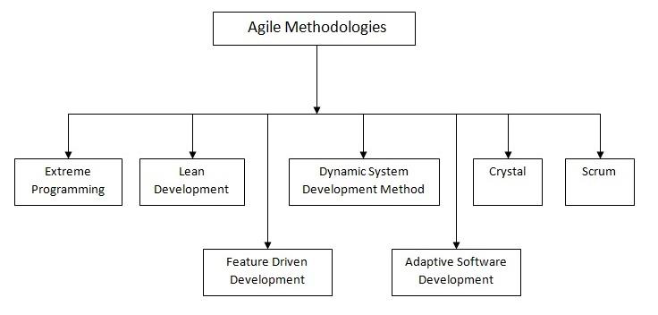
Scrum: The Most Prevelant of Agile Methods

Slide 17
Why Scrum?
Easily scalable.
Simple to understand, difficult to master.
Incremental.
Establishes compliance to expectations.
Adjusts to changes. Adaptive.
Reduces time to market.
Results in higher product quality.
Better time to development predictions.
Reduces risks.
Helps teams adapt to changing market conditions and user requirements.

Slide 18
2.4 Scrum is Empirical
The entire Scrum framework is built on empiricism. The idea of working on short iterations, reviewing results, inspecting and adapting … is empiricism.
That is, Empiricism means working in a fact-based, experience-based, and evidence-based manner. Scrum implements an empirical process where progress is based on observations of reality, not fictitious plans. Scrum also places great emphasis on mind-set and cultural shift to achieve business and organizational Agility.
Notes:
Not linear

Slide 19
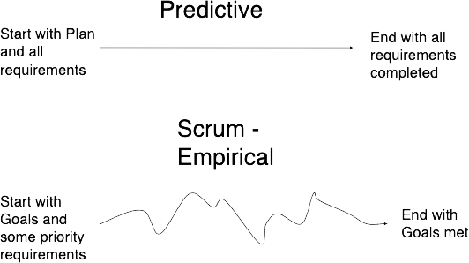
Scrum is Empirical
Customer knows what he wants. Engineers know how to build it. Nothing changes along the way.
Customer discovers what he wants. Engineers discover how to build it. Things change along the way.

Slide 20
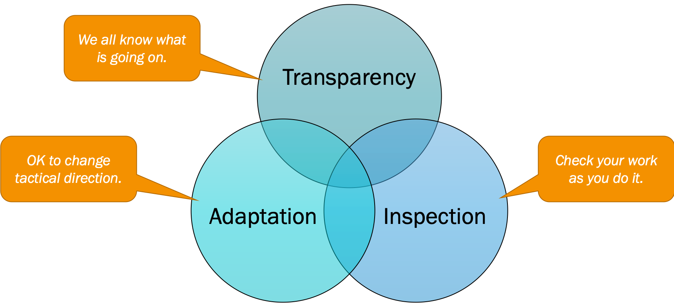
The Three Legs of Empiricism
Empiricism asserts that knowledge comes from experience and making decisions based on what is known.
The entire Scrum framework is built on empiricism. The idea of working on short iterations, reviewing results, inspecting and adapting … is empiricism.

Slide 21
Scrum is Transparent
The process is visible to everyone responsible for the outcome.
Scrum team
Stakeholders
Common standards are defined so observers share a common understanding of what is being seen.
“All on the same page”
For example:
A common language referring to the process must be shared by all participants
Those performing the work and those accepting the work product must share a common definition of “Done”.

Slide 22
Scrum is Transparent
Transparency allows all facets of any Scrum process to be observed by anyone. This promotes an easy and transparent flow of information throughout the organization and creates an open work culture. In Scrum, transparency is depicted through:
Artifacts
Project Vision Document (PID)
Prioritize Product Backlog
Meetings (Sprint Review, Retrospectives)
Release Planning Schedules
Burn Down/Up Charts
Scrum Board

Slide 23
Inspection
Scrum artifacts are frequently inspected and progress towards a goal to detect undesirable variances. Inspection in Scrum can be realized by scrum activities such as:
A Common Scrum Board and other information radiators
Prioritized Product Backlog
Collection of feedback from the customer
Inspection and approval of the Deliverables by the Product Owner and the customer in the Demonstrate and Validate Sprint process.
Their inspection should not be so frequent that inspection gets in the way of the work. Inspections are most beneficial when diligently performed by skilled inspectors at the point of work.

Slide 24
Adaptation
In an Agile world, we always embrace and adapt changes, so that we can constantly improve. Adaptation means that we change what does not work or what could work better.
Scrum prescribes four formal events for inspection and adaptation:
Sprint Planning
Daily Scrum
Sprint Review
Sprint Retrospective

Slide 25
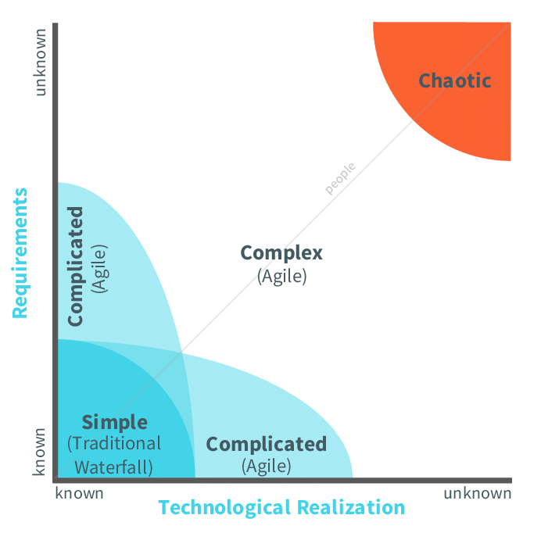
2.5 The Complexity of Software Development
Simple: Everything is known.
Complicated: More is known than unknown.
Complex: More is unknown than known. (Scrum thrives here)
Chaotic: Very little is known.

Slide 26
3. Scrum [Outline]
Waterfall vs Scrum
Characteristics of Waterfall vs Scrum
Scrum: Small feature sets

Slide 27
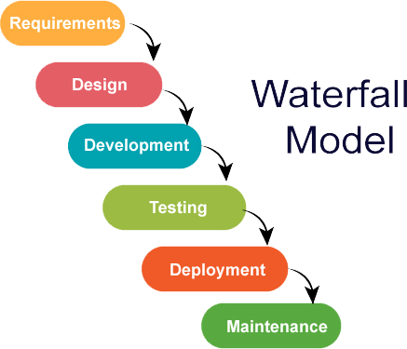
3.1 Waterfall vs Scrum
One step follows the previous step.
The following phase should not start until the previous phase has finished.
Works well with small, uncomplicated projects.
*However, in software development, these stages tend to overlap and feed information to each other.

Slide 28

Problems with the Waterfall Model
The main problem with the Waterfall model is difficulty accommodating change after the process begins. Ideally, each phase should be complete before moving to the next.
Not suitable for situations where software requirements change quickly.

Slide 29
Problems with the Waterfall Model
Managers love waterfall models
Nice milestones.
No need to revisit steps. One activity at a time.
Easy to check progress. How much is completed per unit of time.
Progress is measurable - deadlines
Nice metrics
”Reportable”
Software development is affected
During coding, requirements problems are found.
During testing, coding or requirements errors are found.
During implementation, different stakeholders may be disappointed.
All add up to increase costs and time of development

Slide 30
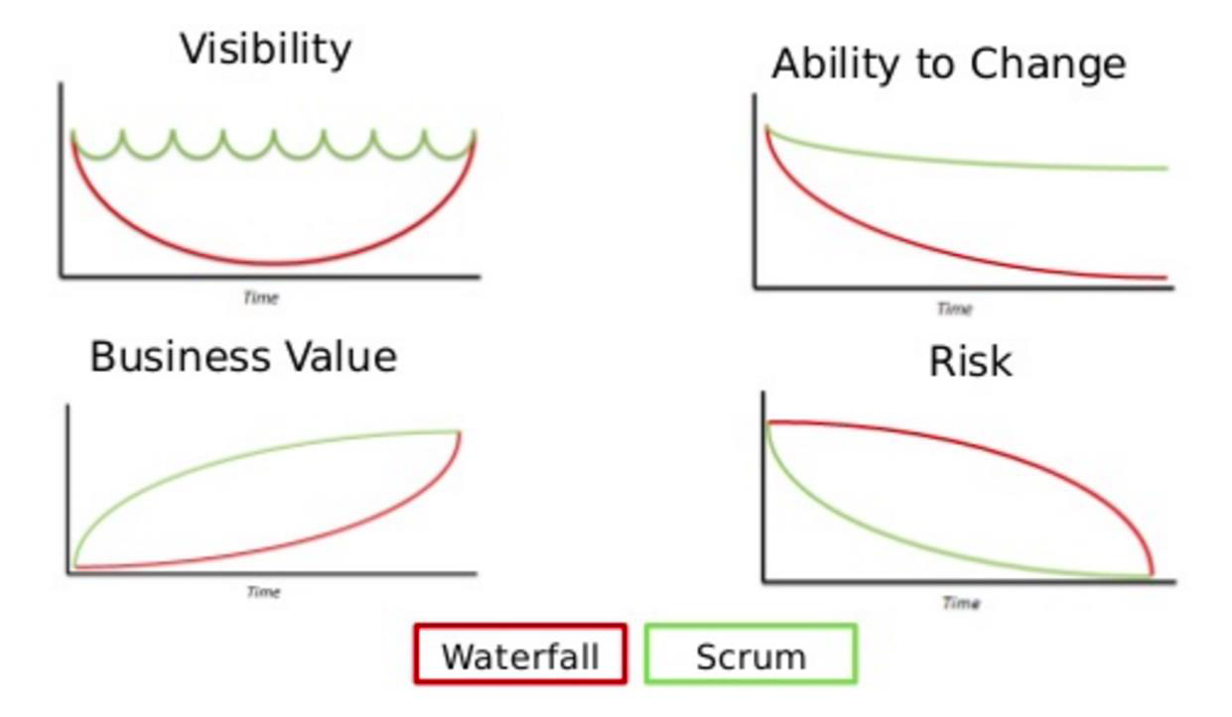
3.2 Characteristics of Waterfall vs Scrum
Notes:
Business value – building something for the customer

Slide 31
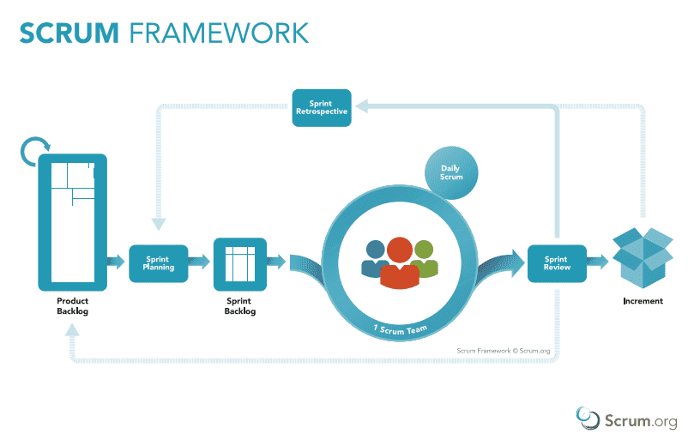



3.3 Scrum: Incremental, Smaller Feature Sets
Plan and analyze to determine product requirements.
Design and develop an increment (potentially shippable product) using a subset of the product requirements.
Test and review your product.
Notes:
Sprint review is with the customer (presenting what you have)
Everyone has a chance to present (not presenting as a team)
Sprint retrospective (now that we’ve presented and got feedback/changes, where should we go from here?)

Slide 32
Scrum: Incremental, Smaller Feature Sets
Plan
Plan
Plan
Scrum revolves around short, iterative release cycles, or Sprints, that allow to to ship often, reprioritize, and constantly improve.
A sprint normally takes 1-3 weeks.
Build
Build
Build
Test
Test
Test
Review
Review
Review

Slide 33
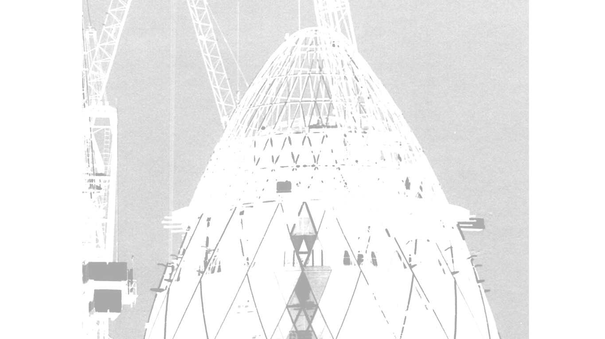

Sprints
Sprint
Plan
Plan
Scrum revolves around short, iterative release cycles, or Sprints, that allow to to ship often, reprioritize, and constantly improve.
A sprint normally takes 1-3 weeks.
Sprint
Sprint
Plan
Build
Build
Build
Test
Test
Test
Review
Review
Review
Potentially Shippable Product
(i.e. alpha, beta, prototype)

Slide 34
Sprints: End with a Shippable Product
Sprint
Sprint
Sprint
Sprint
End with Shippable Product

Slide 35
4. Scrum Roles, Artifacts, and Events [Outline]
Scrum Framework
Sprint Roles
Artifacts
Scrum Events
Scrum in a Nutshell

Slide 36
4.1 Scrum Framework
1. Starts with the Product Backlog (“to do list”)
As the development team starts to build a new product, they have to decompose long lists of stories, features, requirement, and fixes to detailed and specific requirements.

Slide 37
Scrum Framework
2. A sprint is a short, time-boxed period when a scrum team works to complete a set amount of work (potentially shippable product – increment).
Every couple of weeks the team plans which of the tasks from the backlog they’ll work on for the next Sprint.

Slide 38
The Sprint
Sprint: container event: 30 days or less in duration
A container for all activities and the other Scrum events
Focus is on development activities
Starts with Sprint Planning
Ends with Sprint Retrospective
30 days or less to enable regular feedback

Slide 39
The Sprint
All Sprints have consistent duration
Sprints begin as soon as the previous Sprint ends
Scope is negotiated constantly throughout
Between Development Team and Product Owner
This recognizes uncertainty even within the Sprint

Slide 40
Scrum Components
Roles
Product Owner
Development Team
Scrum Master
Artifacts
Product Backlog
Sprint Backlog
Increment
Time-Boxed Events
Sprint
Spring Planning Meeting
Daily Scrum
Sprint Review
Sprint Retrospective
serves
serves
Notes:
Continuous communication

Slide 41
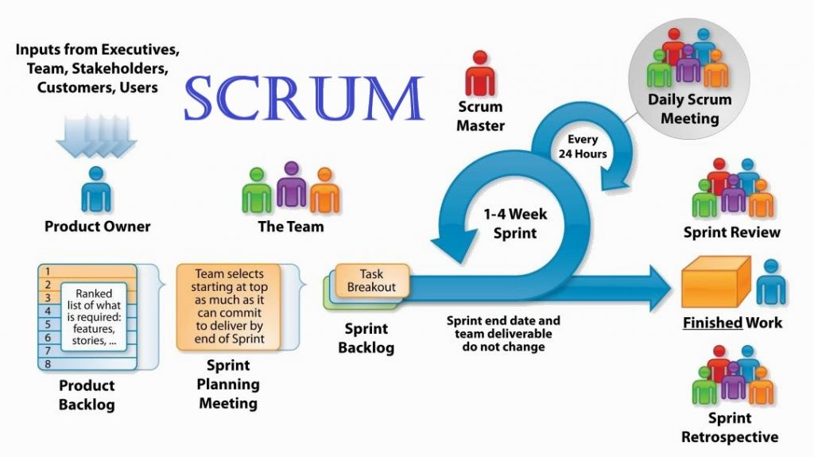
Scrum Components

Slide 42
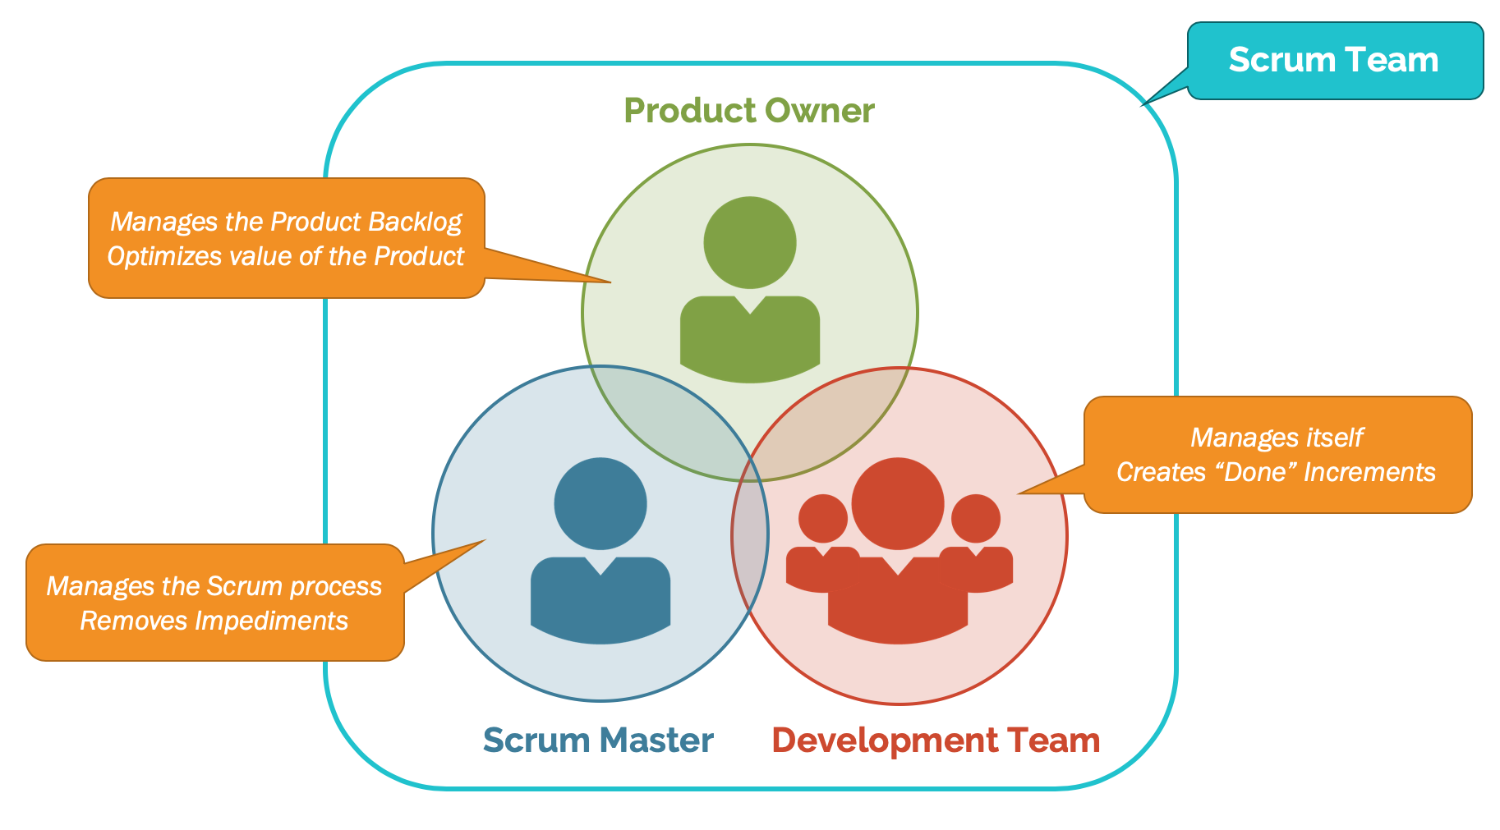
4.2 Three Primary Sprint Roles

Slide 43
Sprint Roles
Their main job is to bring the product vision (idea) to life and have a constant pulse on the market and the customer.
Product Owner: Person responsible for defining product features. The Product Owner acts as a liaison between the customers and the development team. They are responsible for ensuring all expectations for the final output have been clearly communicated and agreed on by stakeholders.
Scrum Master: Team leader. Scrum experts within their team. Member of the team who acts as a liaison between the customers and the development team. This person is the one responsible for making sure that only the best scrum tools and practices are used and keep the project moving forward.
Team Members: Programmers, other “day in and day out” necessary duties and responsibilities. They also think of ways to improve development practices.

Slide 44
The Product Owner
Defines features and functionality
The level of detail provided will vary
Some Product Owners will work closer to implementation details than others
Has the final word on the content and the ordering of the Product Backlog
Not the Development Team's assistant
If a member of the business, it is preferred that the Product Owner not be tasked with writing a User Story
Needs to spend as much time with the Development Team as needed

Slide 45
Role of the Product Owner
The Product Owner is the sole person responsible for managing the Product Backlog. Product Backlog management includes:
Clearly expressing Product Backlog items;
Ordering the items in the Product Backlog to best achieve goals and missions;
Optimizing the value of the work the Development Team performs;
Ensuring that the Product Backlog is visible, transparent, and clear to all, and shows what the Scrum Team will work on next; and,
Ensuring the Development Team understands items in the Product Backlog to the level needed.

Slide 46
The Scrum Master
A servant-leader, management position
Managing the use and adoption of Scrum by the team and within the organization
Serving and coaching the Scrum Team
Embodying agility for all to see
Not the Development Team's assistant
Optional to the Daily Scrum
Is not there to "drive the team" or "drive results"
Is not the agile variant of a Project Manager
Guides and cares for the Team
Adheres to Scrum values, practices and rules
Understands and uses self-organization
Is productive
Increases the quality of Increments
Coaching organization and cross-functionality
Removes impediments to the Development Team's success that they are unable to remove themselves.

Slide 47
Role of the Scrum Master
The Scrum Master serves the Product Owner in several ways, including:
Finding techniques for effective Product Backlog management;
Helping the Scrum Team understand the need for clear and concise Product Backlog items;
Understanding product planning in an empirical environment;
Ensuring the Product Owner knows how to arrange the Product Backlog to maximize value;
Understanding and practicing agility; and,
Facilitating Scrum events as requested or needed.

Slide 48
The Development Team
The team composition is constant throughout a Sprint.
Typically has 3-9 members, with the sweet spot around 6.
May have partially allocated members.
Although this is often considered an impediment as they have other priorities.
For instance, Database Administrators, User Interface Design experts, Technical Writers.
Everyone pitches in regardless of individual skill specialty.
The Development Team is held to account as a unit.

Slide 49
Role of Development Team
They are self-organizing. No one (not even the Scrum Master) tells the Development Team how to turn Product Backlog into Increments of potentially releasable functionality;
Development Teams are cross-functional, with all of the skills as a team necessary to create a product Increment;
Scrum recognizes no titles for Development Team members other than Developer, regardless of the work being performed by the person; there are no exceptions to this rule;
Scrum recognizes no sub-teams in the Development Team, regardless of particular domains that need to be addressed like testing or business analysis; there are no exceptions to this rule; and,
Individual Development Team members may have specialized skills and areas of focus, but accountability belongs to the Development Team as a whole.

Slide 50
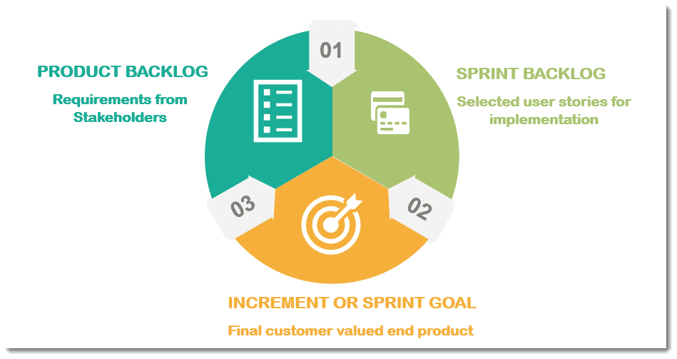
4.3 Scrum Artifacts

Slide 51
Scrum Artifacts
Product Backlog
Sprint Backlog
Increment

Slide 52
Scrum Artifacts
Product Backlog: User stories, what goes into the product – the “idea” behind the product. Describes features of the product. Maintained by the Product Owner.
Sprint Backlog: Unprioritized features and tasks for the product to be implemented. Estimated time for completion. All scrum members are responsible for the sprint backlog.
Increment: The Increment is the sum of all the Product Backlog items completed during a Sprint and the value of the increments of all previous Sprints. At the end of a Sprint, the new Increment must be “Done,” which means it must be in useable condition and meet the Scrum Team’s definition of “Done.” It must be “usable” regardless of whether the Product Owner decides to actually release it.

Slide 53
Product vs Sprint Backlog
Product Backlog: The product backlog is compiled of all the things that must be done to complete the whole project. But it’s not just a simple task list. An effective product backlog breaks down each of the items on the list into a series of steps that helps the development team. There must be a duration, so the team knows when to start the task and how long they have until they must finish it.
The Sprint Backlog is like a subset of the product backlog. The sprint backlog comes from the product backlog, but it contains only that item, or those items, that can be completed during each sprint.

Slide 54
Product vs Sprint Backlog
Product Backlog
Holds the requirements for the Product
A minimal but sufficient inventory of work
An ordered list of requirements
Potential features of the product
The single source of truth for what is planned in the product
Managed by the Product Owner
Consists of Product Backlog Items (PBIs)
Public and available
Sprint Backlog
Holds all work for the Sprint Goal
The selected Product Backlog Items ("forecast" for the Sprint
A plan, often a list of tasks, to deliver the Product Backlog Items against the Sprint Goal
Created by the Development Team during Sprint Planning
Often derived by examining and decomposing PBIs
Might be a simple To Do list
Work for the Sprint emerges during the Sprint
Development Team members sign up for work, they aren't assigned
Development Team members may modify the Sprint Backlog anytime as they see fit
Progress within the Sprint must be visualized
Owned and managed by the Development Team

Slide 55
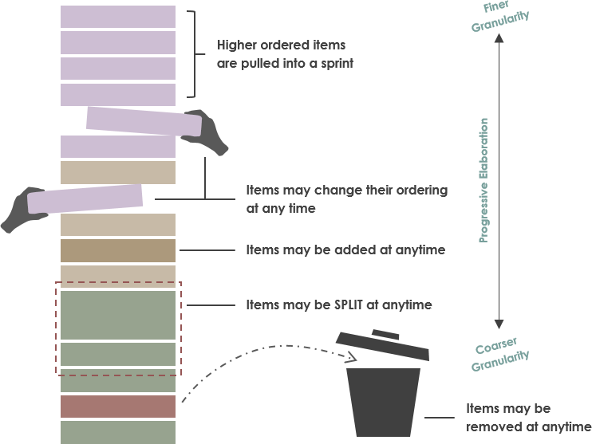
Product Backlog
The Product Backlog is essentially a list of all currently known User Stories and Features for a project, prioritized according to business value. Throughout product development, User Stories and Features are added and removed from this list, which is typically maintained by the Product Owner.
Notes:
Priorities may change

Slide 56
Product Backlog Items
Transparent unit of deliverable work
Contains clear acceptance criteria
Criteria for successful completion
Answering "what will be true when this works"
May reference other artifacts like
Specifications
Mockups
Architecture Models
Must be sized appropriately
Must be “completeable” and “doable” (able to be "DONE") within a single Sprint
Best to have several PBIs in a Sprint
Valid Product Backlog Items
Feature definitions
User actions or stories
Constraints
e.g., The system responds to all search requests within 10 seconds of receiving the request
Bugs / Defects
Behaviors (execution of tasks that can be verified with observation)
Use Cases
Functional requirements
Non-functional requirements
e.g., all database records must be replicated in a remote database environment

Slide 57
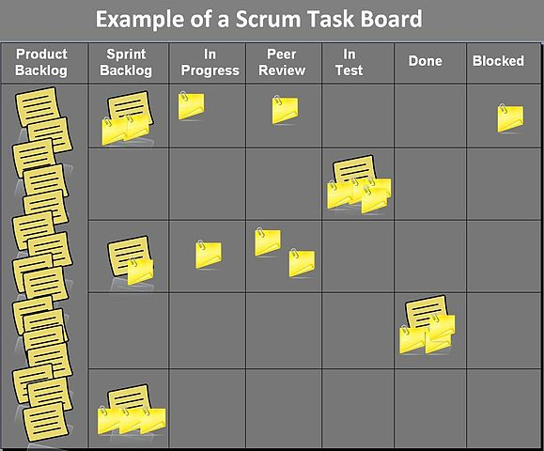
A Scrum Board (Trello)
Scrum says to visualize progress on the Sprint Backlog. A Scrum board is an often used means to do so.
Note PBIs are decomposed to Tasks by the time they are represented in the To Do column.
Notes:
Trello

Slide 58
Proper Use of Scrum Boards (and Trello)
When to move a PBI in a Scrum Board
Product Backlog
Sprint Backlog
Sprint To Do
Sprint In Progress
Sprint Done
Refined and Ready
Decom-posed*
Claimed by Dev
Team member
Complete per
Acceptance Criteria
* In fully functional scrum boards, the decomposed tasks more to "To Do" but the tasks retain their association with the PBI. In Trello, PBIs move as a whole.

Slide 59
Scrum Artifacts: User Stories
What is a User Story?
User stories are short, simple descriptions of a feature told from the perspective of the person who desires the new capability, usually a user or customer of the system. They typically follow a simple template: As a < type of user >, I want < some goal > so that < some reason >.
Although product backlog items can be whatever the team desires, user stories have emerged as the best and most popular form of product backlog items.

Slide 60
Scrum Artifacts: User Stories
User Story: Customer’s Cash Withdrawal
As a Customer,
I want to withdraw cash from an ATM,
So that I don't have to wait in line at the Bank

Slide 61
Scrum Artifacts: User Stories
Acceptance Criterion 1:
Given that the account is creditworthy
And the card is valid
And the dispenser contains cash,
When the customer requests the cash
Then ensure the account is debited
And ensure cash is dispensed
And ensure the card is returned.
Acceptance Criterion 2:
Given that the account is overdrawn
And the card is valid
When the customer requests the cash
Then ensure the rejection message is displayed
And ensure cash is not dispensed
And ensure the card is returned..
Notes:
Associated tasks/cases?
Tearing it down into binary details

Slide 62

Scrum Artifacts: User Stories

Slide 63

Scrum Artifacts: User Stories

Slide 64
4.4 Scrum Events (Ceremonies)
Scrum Ceremonies are meetings and discussions
Sprint planning: Scrum master and team meet to discuss project/scrum story, sizes, and timelines.
Daily scrum: Daily or regular meeting to discuss what has been completed, current status of project, and any other relevant issues.
Sprint review: Where the team demonstrates the product to the Product Owner and what can be improved.
Sprint retrospective: a recurring meeting held at the end of a sprint used to discuss what went well during the previous sprint cycle and what can be improved for the next sprint. The Agile sprint retrospective is an essential part of the Scrum framework for developing, delivering, and managing complex projects.
*In a nutshell, the sprint review is about the product, while the sprint retrospective is about the team.

Slide 65
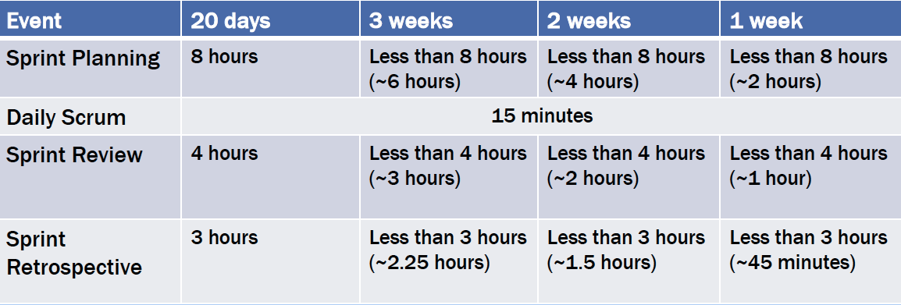
Event and Sprint Lengths

Slide 66
What is Sprint Planning?
1. Sprint planning is a time-boxed meeting that is conducted at the beginning of the sprint, where the team and the product owner discusses and decides on the work that will be completed in the sprint.

Slide 67
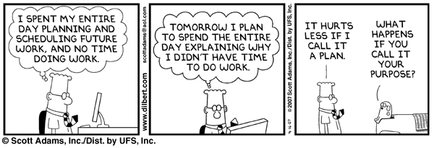
What is Sprint Planning?

Slide 68
Planning for the Increment and Product
The product is the sum of all increments
Release Planning is used to plan out all sprints needed to produce the product.
Can be done at the PBI level.
This way the team can know the approximate size of the effort and can make sure they are marching toward completing that amount of work based in their velocity and total work plan.
Burn up charts and feature burn down charts can be used for this.
Sprint Planning is used to plan the current Sprint, i.e., the current Increment
Has two main topics: What will we do? How will we do it?
8 hours for a 4-week Sprint
Usually less for shorter Sprints
Often the day after the Sprint Retrospective
The full Scrum Team participates
What do you think the activities and responsibilities are during Sprint Planning are for:
Product Owner
Development Team
Scrum Master

Slide 69
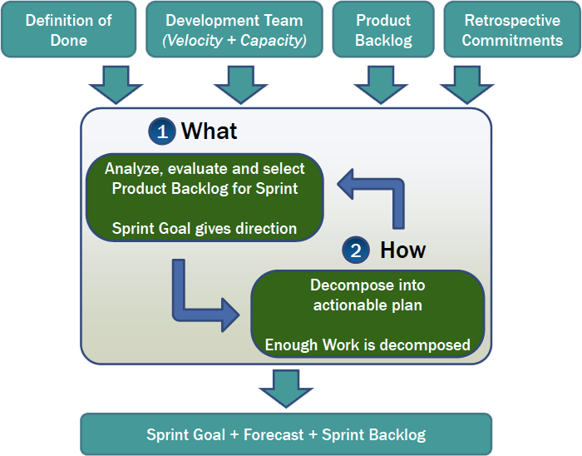
Sprint Planning Meeting Flow
Inputs
Definition of Done
Development Team Capacity for next Sprint
Past performance of the Development Team
Product Backlog
The latest Increment
Retrospective commitments
Outcome
The Sprint Goal
Forecast
Sprint Backlog
60-70% known and accurate
Some work is stubbed out for discovery later

Slide 70
Sprint Planning Meeting Flow
What?
The product owner brings a list of prioritized user stories to the meeting. Ideally, the teams’ velocity will be known and transparent so the product owner has a good idea of how much work should be able to fit in a sprint. This is discussed by the team, they break the user stories down and then agree and commit on work that can be completed in the sprint.
How?
The development team then discusses the agreed upon work, and how to go about completing it. This generally involves the team breaking the user stories down into tasks and going through the technical details. If a team practices regular backlog grooming the team should already have an idea on what the user story is about.

Slide 71
Sprint Planning Roles
Product Owner
Brings in new PBIs, prioritized
Clarifies information
Development Team
Create plan
Ask questions
Scrum Master
Identifies impediments
Conducts risk management

Slide 72
Common Problems with Sprint Planning
PO dictates and deciding what work will be completed
The product backlog is not healthy, prioritized or ready to be discussed
At the end of the sprint, everything is in too much detail and all work is assigned (this is hard to overcome)
No one understands what is actually meant by done.
The meeting is too long
The meeting is not engaging
Some people do not have a voice
Poor environment and the team do not feel support or safe
No trust or respect on both sides
The team does not actually understand why they do this meeting

Slide 73
Monitoring Sprint Progress
Measurement is for the Development Team and no one else
This is part of self-managing the Sprint's work
Measurements are indications of
Progress in the Sprint
If scope should be re-negotiated with the Product Owner
Sprint progress monitoring can be easily misused
To micromanage the Development Team
To demonstrate false progress
Progress may change abruptly when
New work is added or removed during the Sprint
Scope is renegotiated with the Product Owner
New things are learned about the work of the Sprint

Slide 74
The Daily Scrum
The Daily Scrum
15 minute daily meeting
Same place and time
Assess progress of the Sprint goal
Synchronize activies
Create a plan for next 24 hours
Why a Daily Scrum?
Share commitments
Identify impediments
Create focus and awareness
* Good idea to update the Sprint backlog and burndown charts at daily scrum

Slide 75
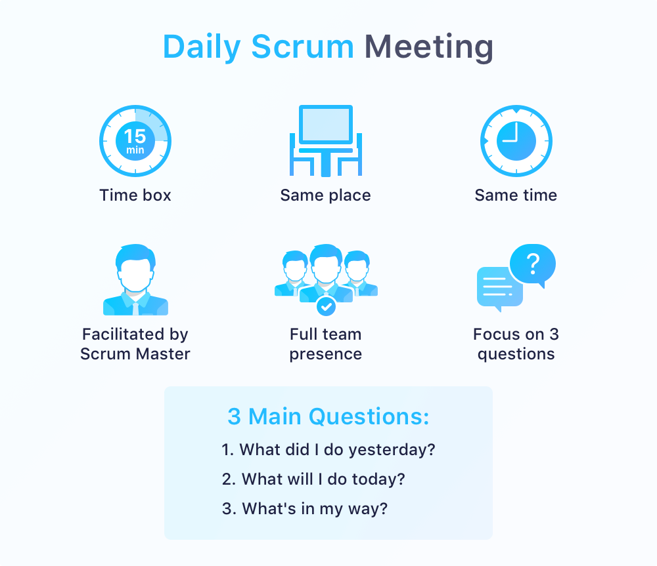
The Daily Scrum

Slide 76
Sprint Review Meeting
Sprint Review: from Sprint, Increment to Updated Product Backlog
You reached the end of your Sprint, it’s time to show off your work and reflect on how things went. Everyone participates.
4 Key Steps:
What’s ”Done” and “not Done?”
Demo the work
Review key metrics
Review and revise the product backlog

Slide 77
Sprint Review Meeting: Who Does What?
The product Increment is inspected with the stakeholders.
Stakeholders are encouraged to provide feedback and to collaborate.
The Product Backlog is updated upon the new insights.
Feedback is heard from all present.
Feedback used to guide the next increment
No slides! Just working software
4 hours for a 4 week Spring
Usually less for shorter Sprints
The full Scrum Team participates
Complemented by the stakeholders
Product Owner
Reviews the Product Backlog and explains which items are done, and not done.
State of the Product Backlog.
Release projections.
Development Team
Shares and demos the increment.
Reviews key metrics. Did the increment achieve your goals?
How problems were addressed.
Everyone provides and hears feedback
Take another look at the Product Backlog.

Slide 78
Sprint Retrospective
1. The Sprint Review is about showing a demo of the work that is completed.
2. The Sprint Retrospective is about identifying areas of improvement to make the next Sprint better.

Slide 79
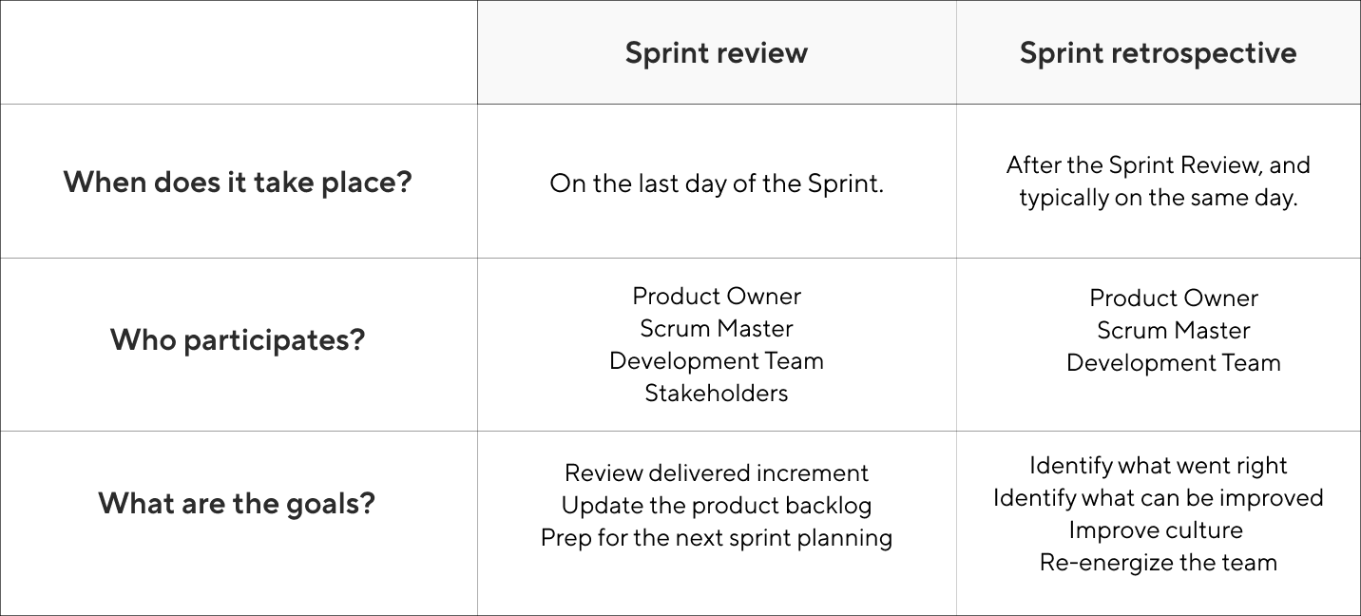
Sprint Retrospective

Slide 80
Sprint Retrospective
Occurs after the Sprint review and before the next planning meeting.
Evaluate how the last Sprint went.
Create a shared understanding of what went well, and what didn’t.
Create a plan for improving the way that your team works.
Full Scrum Team participation
A discussion of
The Scrum process
Scrum Team members behaviors
Tools used and needed
Expanding the Definition of Done (based on Sprint Review)
Goal: to find actionable improvements
The Scrum Team can enact on the next Sprint
To adapt common practices and techniques
To increase the Definition of Done
5 Basic steps to run through a retrospective:
Prepare.
Set the stage.
What went well.
What needs improvement? What we will commit to improve in the next Sprint.
Next steps.

Slide 81
Sprint Retrospective
What you might need
To prepare: White board, sticky notes, pens, timer. No cell phones.
Setting the stage: Remain focused on outcomes (not individuals). Be positive – not a complaining session. Be honest. Listen with an open mind.
What went well: Key strengths. Outcomes. Team members write brief “idea” per sticky note, creating a shared understanding of what it means. Group similar themes.
What needs improvement. Same as #3. Actions and outcomes that could have been better.
Wrap up with next steps.

Slide 82
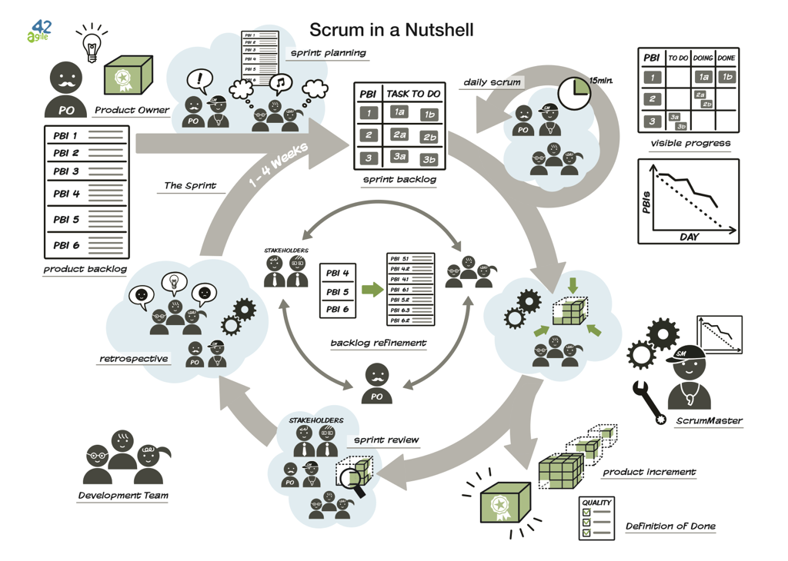
4.5 Putting It All Together

Slide 83
5. Done [Outline]
Definition of “Done”

Slide 84
5.1 Definition of “Done” (DoD)
An increment is deemed complete after the Sprint meets its “Done” criteria and their acceptance criteria.
So the definition of “Done” is based on the agreed criteria that must be met for a team to consider an aspect of the project is shippable or complete.
Think of it as a checklist that defines what’s needed for an Increment to be releasable at the end of a Sprint.
The team decides what is “done”

Slide 85
Definition of Done vs Acceptance Criteria
Definition of Done (DoD) is a list of requirements that a user story must adhere to for the team to call it complete.
While the Acceptance Criteria of a User Story consist of set of Test Scenarios that are to be met to confirm that the software is working as expected.
Short Answer: Definition of Done is about building the product “right,” and Acceptance Criteria is about developing the “right” product.

Slide 86
The Definition of Done (DoD)
The DoD is NOT the same as Acceptance Criteria
The Definition of Done is a clear and concise list of requirements that the user story must satisfy for the team to call it complete.
The DoD is a list of technical and non-technical requirements for each user story to meet for the project. It must apply to all items in the backlog.
DoD is a contract between the Scrum Team & the Product Owner.
User story Acceptance Criteria can be modified over the course of the Sprint as the user story is further refined.
The DoD is set during the Release Planning or Sprint – not generally modified once active development print cycles are underway.
The DoD is often confused with acceptance criteria because, like acceptance criteria, it is used to prove that a story is complete.
The difference with the DoD is that it is a list of requisites that determine that a story meets company or project requirements, instead of only technical requirements.

Slide 87
Is it Done?
Decide on your definition of done as a team
Create a checklist template for your definition of done
Don’t obsess over the list of criteria
Make sure each individual task has its own specific acceptance criteria
Check your DoD against organizational needs

Slide 88
Is it Done?
Unit test passed
Code reviewed
Acceptance criteria for each issue met
Functional tests passed
Non-functional requirements met
Product owner accepts the User Story
Notes:
Functional: what do we need to make this work
Non-functional: what constraints are there?

Slide 89
Is it Done?
Code is written. The most basic thing that needs to be completed for any user story or issue to be “done” is that it’s built.
Code is documented. At this level, you most likely want to have some developer documentation finished and made accessible. Depending on the size of the project, you might also want to create some form of help documentation for the handoff to support (who will be answering questions about the release to users).
Code review has been completed. As part of your sprint, you’ll want to get your code ready for review with clear metrics (and acceptance criteria) set. To be “done”, the code needs to be checked by your team for any issues or bugs.
Build has been made and deployed on a testing environment. Your definition of done needs to expand beyond just the scope of writing code. By including a deploy in it, you’ll help keep your sprints on track and also keep the end goal in mind for developers.
Tests have been passed. Does it work? Before you can be done, you need to make sure you’ve gone through your test plan and make sure you didn’t break anything else in the meantime.

Slide 90
6. Sprint Techniques [Outline]
Hitting a Spike
Burndown and Burnup Charts

Slide 91
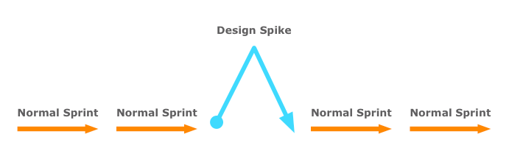
6.1 Hitting a Spike
The purpose of Spike is to gain the knowledge necessary to reduce the risk of a technical approach, better understand a requirement, or increase the reliability of a story estimate.
The spikes that teams take on are often proof-of-concept types (prototypes) of activities.

Slide 92
Hitting a Spike
Technical Spike
The technical spike is used more often for evaluating the impact new technology has on the current implementation that the team needs experiment a new technology to gain more confident for a desired approach before committing new functionality to a timebox.
i.e. “how long it takes to update a customer display to current usage, determining communication requirements, bandwidth, and whether to push or pull the data”
Functional Spike
A functional spike are used whenever there is significant uncertainty as to how a user might interact with the system. Functional spikes are often best evaluated through some level of prototyping, whether it be user interface mockups, wireframes, page flows, or whatever techniques is best suited to get feedback from the customer or stakeholders.,
i.e. “Prototype a histogram in the web portal and get some user feedback on presentation size, style, and charting”

Slide 93
Hitting a Spike
Once the solution is identified, the person who was working on Spike, will document the approach and share it with the team.
The Product Owner will create a new implementation story.
In the sprint planning session, the Product Owner will prioritize the story.
The team will estimate the story and start work on it.
Spikes should be timeboxed.

Slide 94
6.2 Burn-down and Burn-up Charts
What is a burn-down chart?
A Burn-down chart is defined as a visualization tool, also used in Scrum & Agile-based products, that helps in determining how much work is left to be done and the time remaining for the same. The graphical representation helps in predicting the method that the Scrum Team plans to undertake in completing the product within the current allotted time.
What is a burn-up Chart?
A Burn-up chart is defined as a tool that is used in Scrum & Agile-based products that helps in the visual representation of a Scrum Team's overall progress of the work that they're doing. The chart will help in showcasing the total scope of the product along with the work that has been completed so far.

Slide 95
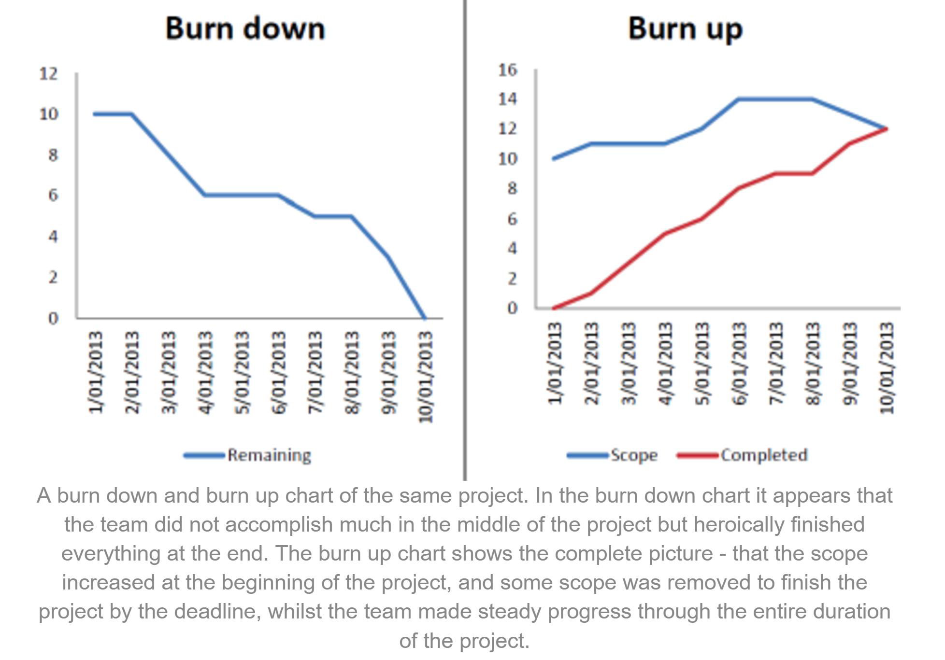
Burn-down and Burn-up Charts

Slide 96
Burn-down and Burn-up Charts
Utilization | Both Burn-up & Burn-down charts are commonly utilized in Scrum & Agile-based product development efforts
Remaining work measurement | Both charts are capable of measuring the amount of remaining work needed to be done in a product, based on the respective completion timeframe
Understandability | Both charts are simple & easy to understand.
Creation | Both Burn-up & Burn-down charts can either be created manually using pen & paper, without any hassles. Or these charts can be created using any spreadsheet program such as Microsoft Excel.

Slide 97
Burn-down and Burn-up Charts
The target audiences
Since the Burn-down chart tends to be more basic than Burn-up charts, it's highly appropriate for audiences who just want to know about the Product progress (at any given time) and nothing else.
But, on the other hand, the Burn-up chart is a great tool for those audiences who want to take an in-depth look at how the Product Manager managed the entire product throughout the timeline.
The product changes
Burn-down charts are usable for products which contain little to no changes in the overall number of tasks or features which are already assigned.
Alternatively, if a product is subjected to multiple features or tasks alteration, then Burn-up charts make more sense.

Slide 98
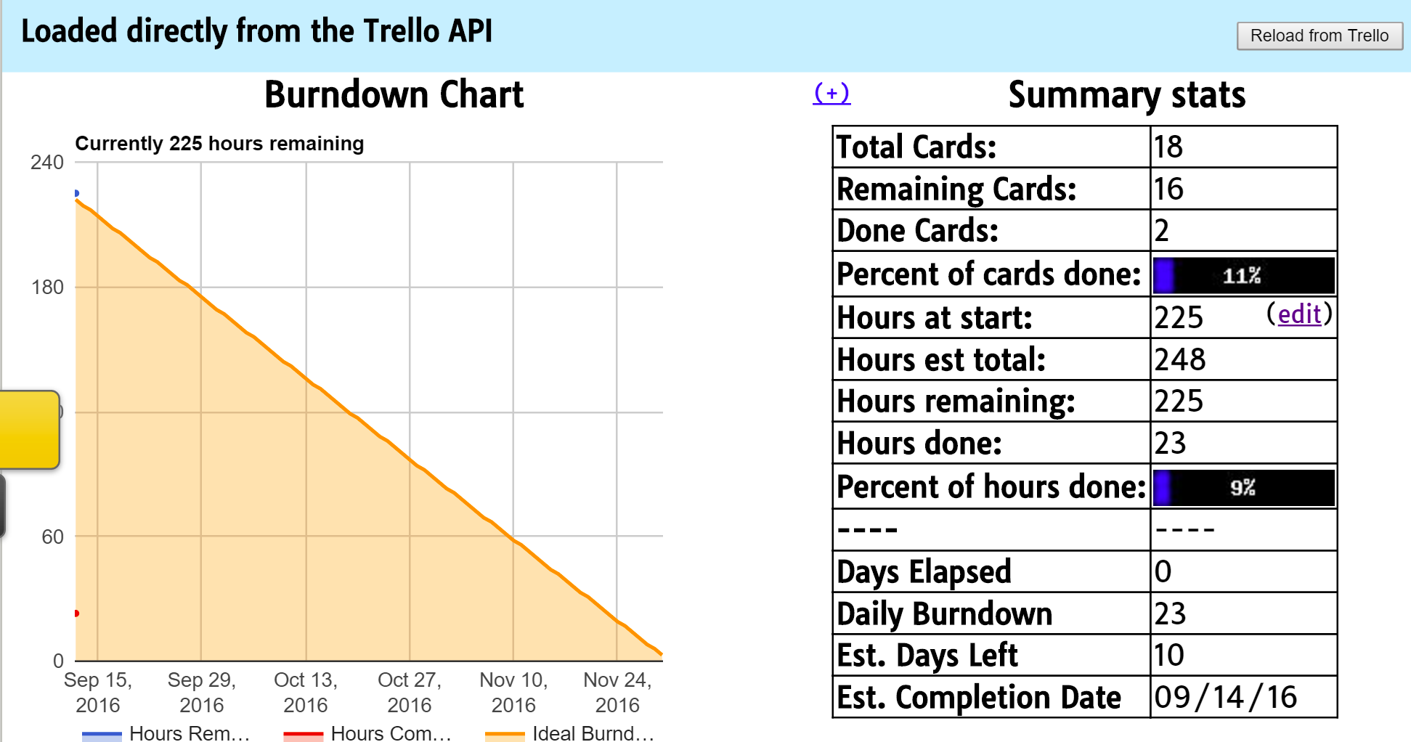
Burn-down for Trello

Slide 99
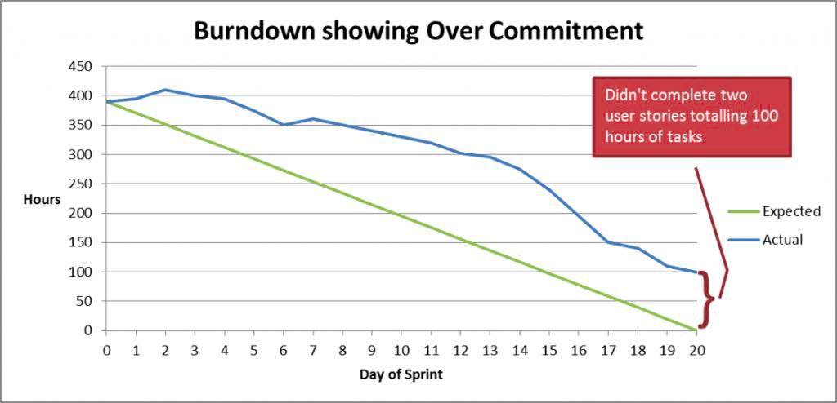
Burn-down Can Show Over-Commitment

Slide 100
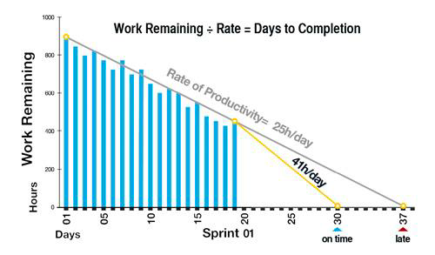
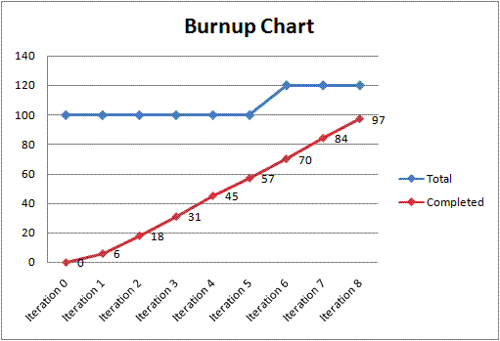
Project Visualization
Sprint Visualization
Use Trello's Burn Down capability (Or Excel with difficulty on Y axis)
Accept hours as unit for Y axis
Update at Daily Scrum
Release Visualization (Sprints 1 to 5)
Use Burn Up charts
Create two charts
1 with Business Value on the Y axis
1 with Effort (PBI Sizing) on the Y axis
Update prior to each Sprint Review

